Slide 1

Παρουσίαση XAI εργαλείων
Α.Ε. Τσιμέντων ΤΙΤΑΝ
Μέξης Κωνσταντίνος

Slide 2
Partial Dependence Plots (PDP)

Slide 3
Basic idea
Key question: “How do the model inputs work?”
  How do changes in a particular X variable affect the model’s predictions.
PDP show the functional relationship between model inputs and the model’s predictions
PDP show how the model would respond if you increase or decrease x
  X-axis: levels within the chosen feature variable
  Y-axis: average scored predictions for each level

Slide 4
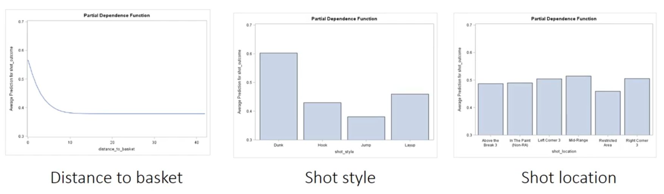
Example: Top inputs predicting NBA shot success

Slide 5
Example: Top inputs predicting NBA shot success
Insted of assuming that all levels within a variable have the same linear effect, a PDP can reveal which levels have more or less infuence on the target determined by a black-box model
For a single numerical feature, the ALE value can be interpreted as the main effect of the feature at a certain value compared to the average prediction of the data
  This interpretation is made possible because ALE plots are centered at zero

Slide 6
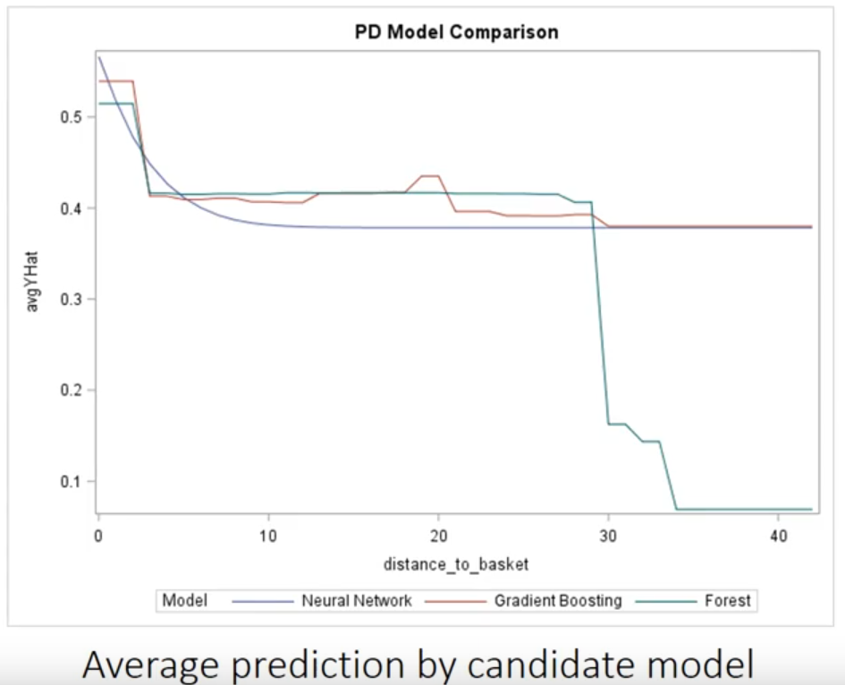
PDP can be used to compare models
Overlaying PDPs can help you choose models that are not only accurate but also make intuitive sense

Slide 7
PDP computing steps
Step
1. Find unique values of plot variable
2. Create data set of complementary model inputs
3. Replicate and score
4. Compute average predicted value for each replicate

Slide 8
Limitations
PDP assumes independent features
PDP can be misleading if there are correlations between the predictors in the model
Interpretation methods less sensitive to correlation could be used together with PDP
Unrealistic observations could be simulated during the process of replicating the data sets, which could lead to misguided interpretation

Slide 9
Example: Basketball Teams
Dataset
# Games Won
# Games Lost
# Injuries
Total Years of Experience
M
Prediction

Slide 10
Example: Basketball Teams
A ML model predicts the probability that the team will win next match
  Question: How does each feature affect the prediction?
PDP gives the answer!
Ex. How #Games Won affect the final predicted probability

Slide 11
Example: Basketball Teams
Create Artificial Data
Set #Games Won = 0 to all rows of the dataset
Use model to get the predicted probability for every row
Get the average of those predicted probabilities
  That number is meant to represent what is the on average predicted probability of winning your next game if you have #Games Won = 0 so far.

Slide 12
Example: Basketball Teams
Create Artificial Data
Set #Games Won = {1, 2, 3, …} to all rows of the dataset
Use model to get the predicted probability for every row
Get the average of those predicted probabilities

Slide 13
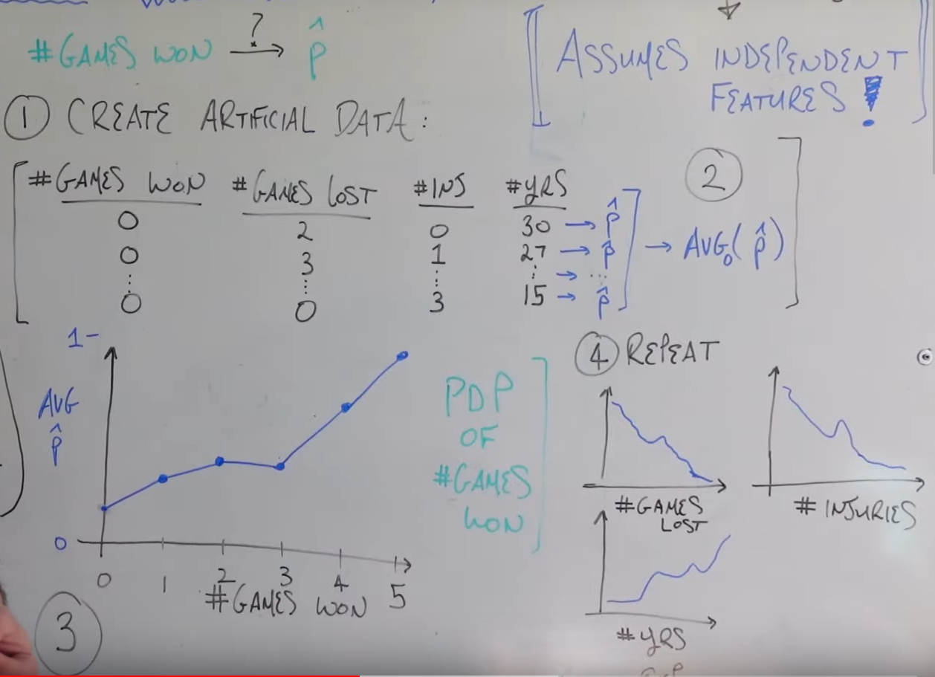
Example: Basketball Teams

Slide 14
Accumulated Local Effects Plot (ALE)

Slide 15
Basic idea
ALE are a strong alternative when predictors are correlated and PDP may be an incomplete representation
Also discribe how a feature affects the prediction on average
ALE averages the difference in predictions for specified intervals within the domain of the given feature
By averaging the difference rather that averaging across the entire domain nullifies the effect of other correlated variables

Slide 16
Basic idea
PDP: “Let me show you what the model predicts on average when each data instance has the value v for that feature. I ignore whether the value v makes sense for all data instances.”
v.s.
ALE: “Let me show you how the model predictions change in a small “window” of the feature around v for data instances in that window.”

Slide 17
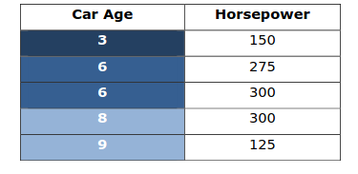
Example: Car Horsepower

Slide 18
Example: Car Horsepower
Three intervals have been established for the Car Age variable – 1:4, 4:7 and 7:10
Each instance is replicated and scored by replacing the upper and lower limits of the interval
Take the difference of the predictions

Slide 19
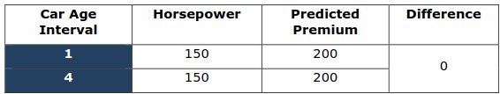
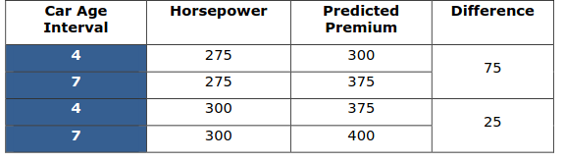
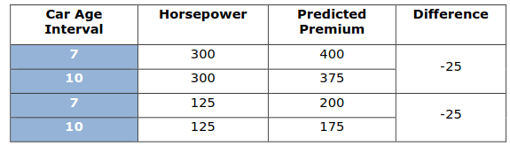
Example: Car Horsepower

Slide 20
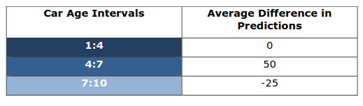
Example: Car Horsepower
Once all differences have been calculated, they are averaged within the interval

Slide 21
Example: Car Horsepower
The final step is to plot the average differences within each interval.
  Y-axis: the average differences between the predictions
  X-axis: take the same values as the predictor.
Because the effects are isolated to intervals, the slope of the average differences will change at the midpoint of each interval, rather than the changing in relation to original values of the predictor

Slide 22
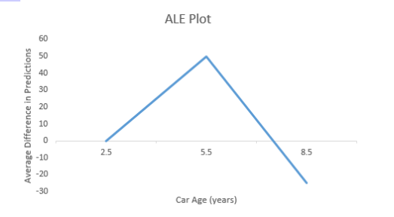
Example: Car Horsepower

Slide 23
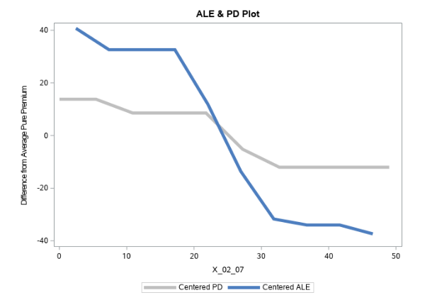
PDP vs ALE
The disparity in behavior between ALE and PDP can be explained by the fact that the variable X_02_07 is strongly correlated with other variables in the model

Slide 24
PDP vs ALE
The relatively flat appearence of the PDP line is commonly observed when model inputs are correlated

